Slide 1



Classification of Fire Types in
India using MODIS Satellite Data
https://github.com/Peddamangari-Manoj/Deforestration_fire_detection.git

Slide 2

Learning Objectives
Understand the role of satellite imagery in environmental monitoring
Analyze MODIS satellite fire detection data to identify patterns
Learn to clean, preprocess, and transform raw spatial-temporal data
Apply outlier removal techniques such as the IQR method
Encode categorical data and scale numerical features for machine learning
Handle imbalanced datasets using SMOTE (Synthetic Minority Over-sampling Technique)
Train and evaluate a Random Forest classification model to detect fire types
Interpret model results and use classification reports for performance assessment
GOAL
Source :
www.freepik.com/

Slide 3
Tools and Technology used
Source - Dataset: MODIS Satellite Data (2021, 2022, 2023) - Data Provider: NASA FIRMS
(https:// firms.modaps.eosdis.nasa.gov)
Tools and Technologies Used –
Python
Pandas
NumPy
Scikit-learn
Imbalanced-learn
Jupyter Notebook
Goal : To classify the type of fire detected from satellite data into categories like natural fire, prescribed fire, etc., using machine learning techniques.

Slide 4
Methodology
Load and merge 2021-2023 MODIS datasets
Clean and preprocess data
Handle missing values and convert date-time fields
Remove outliers using IQR method
Encode categorical features using one-hot encoding
Normalize numerical columns such as brightness and frp
Apply SMOTE to generate synthetic samples for minority classes
Train a RandomForestClassifier on the balanced dataset
Evaluate model using classification metrics and save model for future predictions

Slide 5
Problem Statement:
Wildfires are becoming increasingly frequent and destructive across various Indian states.
Traditional methods of detection and classification are reactive and time-consuming.
Leveraging satellite data and machine learning offers a proactive solution to identify fire types quickly and accurately
which can help allocate resources efficiently and minimize ecological damage.

Slide 6
Solution:
Integrate and preprocess MODIS fire datasets for multiple years
Identify and select critical features that influence fire behavior
Balance the class distribution using SMOTE to address under-represented fire types
Train a machine learning model capable of classifying fire types with high accuracy
Enable early intervention and intelligent fire type forecasting using satellite data insights

Slide 7
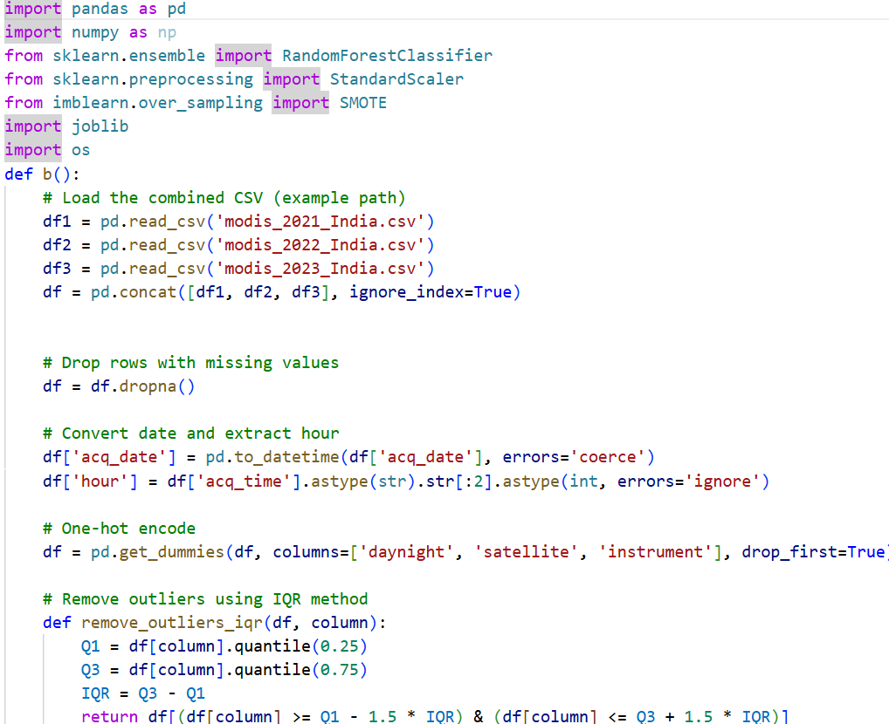
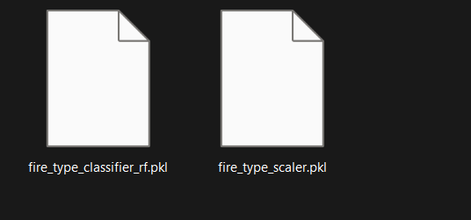
Step 1: Training and generating of Model

Slide 8
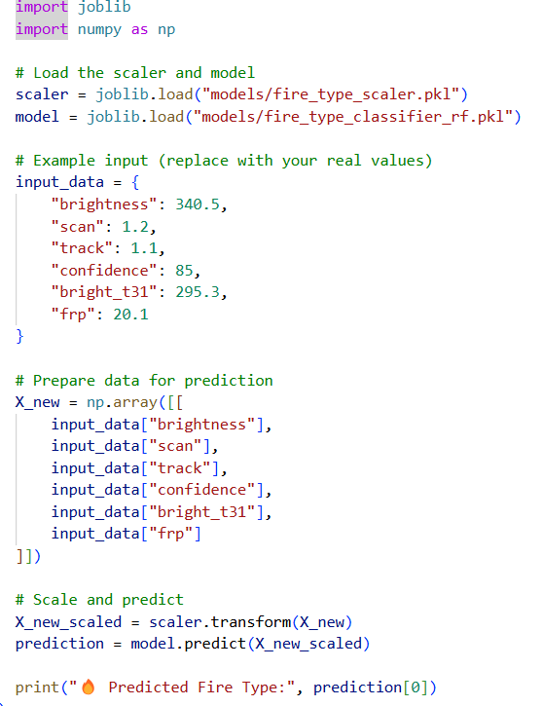
Step 2: Utilising of generated Model for testing

Slide 9
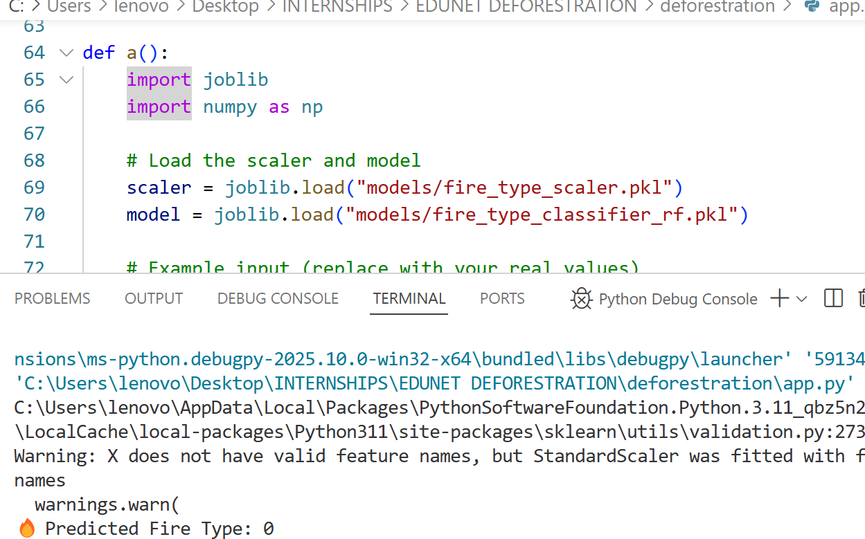
Screenshot of Output:

Slide 10
Conclusion:
Successfully classified fire types using satellite data with a robust machine learning pipeline
Preprocessing techniques such as scaling, encoding, and SMOTE contributed to model efficiency
Random Forest Classifier achieved good performance in handling class imbalance and non-linear patterns
The model can be expanded or deployed in real-time monitoring systems to support environmental management and disaster preparedness

Slide 11
Thank you

